Slide 1
Sensitization Workshop on SDG to District Line Department TOPIC: Concept & overview of SDGs in Mizoram and Localization of SDG

Slide 2
Meaning of SDG
Sustainable Development Goals is development that meets the need of the future without compromising the needs of the present generation.

Slide 3
ORIGIN OF SUSTAINABLE DEVELOPMENT GOALS 2030
25th September 2015 – Adopted by 193 countries at 70th Summit of UN held at New York under the official agenda “Transforming our world: the 2030 Agenda for Sustainable Development”.
1st January 2016 - Officially came into effect.
17 Goals and 169 Targets with 306 indicators.

Slide 4
17 GOALS OF SDGS
Social
Goal 1 - No poverty
Goal 2 - Zero Hunger
Goal 3 - Good Health & Wellbeing
Goal 4 - Quality Education
Goal 5 - Gender Equality
Goal 6- Clean Water & Sanitation

Slide 5
17 GOALS OF SDGS
Economic
Goal 7 - Affordable & Clean Energy
Goal 8 - Decent Work & Economic Growth
Goal 9 - Industry Innovation& Infrastructure
Goal 10 - Reduce Inequalities
Goal 11 - Sustainable Cities & Communities

Slide 6
17 GOALS OF SDGS
Environmental
Goal 12 - Sustainable Consumption & Production
Goal 13 - Climate Action
Goal 14 - Life Below Water
Goal 15 – Life on Land

Slide 7
17 GOALS OF SDGS
Fostering Peace and Partnership
Goal 16 - Peace, Justice & Strong Institution.
Goal 17 - Partnership for the Goals

Slide 8
The key factors for Sustainable Development Goals includes:
Inclusive (Government, Organization, Public).
Universal (Apply to all Countries involving the entire Community taking into account different national realities).
Integrated ( Promotes integration of economy Environment and Society).
Technologically Driven ( New technology offers tremendous opportunity to deliver public services including health care, education and basic infrastructure at lower cost covering more people).
Locally Focus ( Local authorities and communities are responsible for the realization of SDGs goals at local level thereby promoting decentralization).

Slide 9
SDGs Implementation Framework in India
NITI Aayog is the Nodal Agency in India which undertakes mapping of SDG Goals and Targets with Schemes, identification of Nodal Ministries and Government Departments for each of the Goals and Targets.

Slide 10
SDG IN MIZORAM
Planning & Programme Implementation Department is the Nodal Department for implementation of SDGs in Mizoram.
The Mizoram Vision 2030 aiming to achieve ‘Inclusive and Sustainable Development towards shared prosperity’.

Slide 11
The following committees and Cell has been constituted to coordinate SDGs implementation and Monitoring of SDG in the State:
1. High Level Monitoring Committee:
The Committee is set up under the Chairmanship of Chief Secretary, Government of Mizoram with Planning Secretary as Member Secretary.
Members are Secretaries of GAD, Finance, Health & Family Welfare, Rural Development, Urban Development & Poverty Alleviation, School Education, PHE and Social Welfare Departments.
The Committee is constituted to review progress and to suggest corrective measures while monitoring the progress of implementation of SDGs in the State.

Slide 12
Cont..
2. Technical Committee on SDGs
The Committee is formed under the Chairmanship of Director, Economics & Statistics Department where all Nodal Officers of Line Departments are members.
The Committee aims to identify the achievable indicators clearly specifying the baseline data and targets.
The Committee identified 147 State schematic indicators and in achieving the outlined 17 Goals.

Slide 13
Cont..
3. SDGs Cell
A dedicated SDGs Cell has been established in Research & Development Branch of Planning & Programme Implementation Department headed by the Principal Adviser-cum- Additional Secretary.

Slide 14
SDG at District level
1. District Planning Committee (DPC)
District Planning Committee (DPC) is constituted in all the 8 Districts under the chairmanship of the concerned District Commissioner. District Research Officer (DRO) of each District is the Member Secretary of this Committee.
The Committee will review the progress and coordinate the implementation of SDGs in both the District and in the Village Level.

Slide 15
Action taken towards implementing SDGs in Mizoram
1. Mizoram Vision 2030:
Mizoram Vision 2030 was published in 2018. It contains Vision Statement, Overview of SDGs, Landscape analysis and framework of the SDGs implementation. Mapping of the State Departments, Agencies and Developments Programmes and schemes are also included.

Slide 16
Cont..
2. Baseline Survey:
Baseline survey was conducted with three tier monitoring system. Technical Committee on SDG have been conducted frequently indentify indicators, to validate and analyze data and to monitor the SDG Dashboard. Total of 147 State Indicator has already been developed and District Indicator Framework (DIF) is under process.

Slide 17
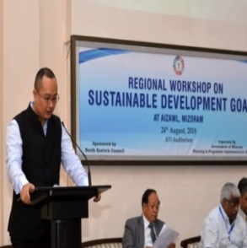
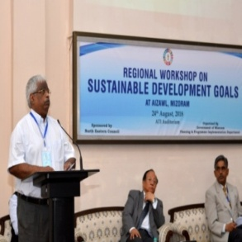
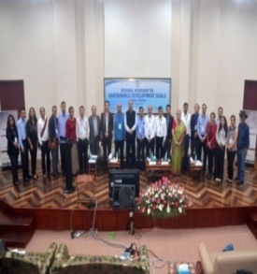
Cont..
3. Regional Workshop:
Regional Workshop for the North East Region was conducted at Aizawl on 24th Aug 2018. Representative from UNDP, NITI Aayog, Ministry of Statistics & Programme Implementation, Academic Institutes and sister States of the Region attended the Workshop.

Slide 18
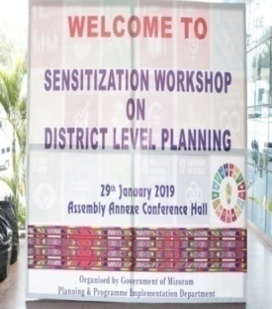
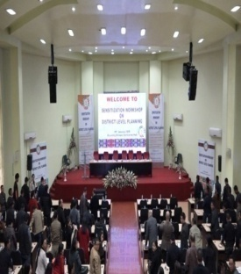
Cont..
4. State level Sensitization Workshop:
State Level Sensitization Workshop on SDG and kick off of District Level Sensitization Workshop on SDG was held at the Assembly Conference Hall on 29th Jan 2019.

Slide 19
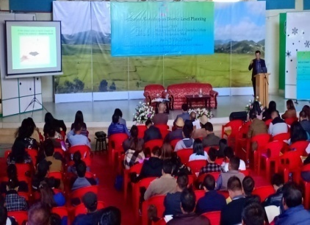
Cont..
5. District level Sensitization Workshop :
District level Sensitization Workshop on SDG was held in all other Seven District headquarters during 31st Jan to 5th Feb 2019.

Slide 20
Cont..
6. Wall hanging:
Wall hanging on 17th Sustainable Development Goals have been prepared in two sizes and distributed to all Government offices, conference halls. One size of SDGs Goals have also been prepared and distributed to educational institutions.

Slide 21
Contd..
7. Video clips on SDGs:
Video clips on SDGs in local languages have been circulated in Local Television Channels and Social media and can be accessed to youtube link: http://youtube/FQK0ZuF1Nms.

Slide 22
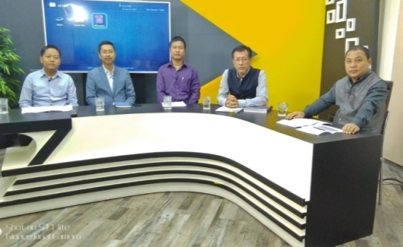
Contd..
8. Talk show:
Talk show was organized on Sustainable Development Goals (SDG) in Zonet Local TV Channel with panel of experts from Academicians and Officials from Planning & Programme Implementation Departments. Recorded discussions can be accessed in youtube link https://youtube/lmFVtiNCJk

Slide 23
Cont..
9. Mizoram SDGs website:
Mizoram SDG Website has been created recently with a link: https: //sdg.mizoram.gov.in. All actions taken and progress report of SDGs in the state will be incorporated to the web.
10. SDG Inter- College Quiz:
SDGs inter College quiz was organized in collaboration with MZP on 8th August-11th August 2019.

Slide 24
Partnership for implementation of SDGs in Mizoram
At the international level, UNDP has been an active partner in technical matters. Several discussions have been held with UNDP at Aizawl and Guwahati.
At the institutional level, we have been partnering with Mizoram University, ICFAI University Mizoram, Administrative Training Institute (ATI) and State Institute of Rural Development and Panchayati Raj (SIRD&PR) for technical issues.

Slide 25
LOCALIZATION OF SDGS
Implementation of the SDGs started worldwide in 2016. This process can also be called "Localizing the SDGs’.
The foremost objective of SDG is to ensure that ‘No One is Left Behind’.
Crucially important as implementation of SDGs happens mostly at the local level.
Defining needs and priorities aligning with development schemes and programmes in term of SDGs targets.

Slide 26
WHAT WE NEED TO DO
Concerted efforts in all aspects so as to achieve ‘Leaving no one behind’
Thank you !

